Slide 1

"Lexical Analysis of Academic Evaluation Scripts: A Compiler Design Approach"
Presented By:
Name: R. Navya Sai
Reg no: 192210628
Course Code: CSA1429
Course Name: Compiler Design for Industrial Automation
Date:20/03/2024

Slide 2
Abstract
The lexical analyzer is the first phase in the compilation process, responsible for breaking down source code into a sequence of tokens, facilitating further analysis such as syntax and semantic checking.
This study explores lexical analysis, a core aspect of compiler design, for processing and interpreting academic evaluation scripts.
The system is designed to be scalable, adaptable to different formats and evaluation contexts, and optimized for high performance in large-scale educational environments.
The implementation utilizes finite state machines (FSM) and regular expressions for efficient pattern recognition, with the ultimate goal of enhancing the accuracy, speed, and automation of academic evaluations.
Leveraging compiler-based techniques, the model minimizes subjectivity in grading by enforcing predefined linguistic and domain-specific rules.

Slide 3
Introduction
Evolution: The evaluation of academic scripts has evolved from manual grading to technology-driven automated assessment systems, enhancing efficiency and accuracy.
NLP Importance: Natural Language Processing (NLP) plays a crucial role in understanding student responses, enabling intelligent feedback and evaluation.
Grammar Checking: Automated lexical analysis helps in detecting grammatical structures, spelling errors, and syntactic inconsistencies in academic scripts.
Real-World Applications: Compiler-based lexical analysis techniques provide structured methodologies to tokenize, categorize, and analyze textual content for academic grading.
Integration: The fusion of compiler design principles with educational assessment tools improves the accuracy and fairness of evaluations, reducing human bias.

Slide 4
Importance of NLP in Language Learning
Problem Faced: Traditional evaluation methods struggle with inconsistent grading and subjective bias in assessing academic scripts.
Solution Offered: NLP-driven error detection enhances feedback quality by identifying spelling, grammar, and conceptual errors.
Benefits: Enhances accuracy by reducing human bias and subjectivity in grading.
Approach
Data – Gather academic evaluation scripts from various sources, including handwritten and digital responses, to build a diverse dataset for analysis.
Model – Develop a compiler-based lexical analyzer that tokenizes student responses, identifying keywords, operators, identifiers, and syntactic patterns.

Slide 5
Overview of Tokenization of Evaluation Scripts
Text Segmentation Tokenization helps in breaking down evaluation scripts into manageable components, such as words, phrases, and symbols.
Language Analysis Facilitates grammatical and syntactic analysis by categorizing words into meaningful tokens.
Context Recognition Enhances contextual understanding by detecting relevant phrases and keywords in student responses.
Enhanced Learning Tools Provides a structured token framework that aids in automated assessment and feedback for students.
Improves the accuracy and fairness of evaluations by eliminating ambiguities in text interpretation.

Slide 6
Lexical Analyzer Implementation
Develop a lexical analyzer using Flex (or similar tool).
Input: Evaluation scripts in a standardized text format.
Output: Stream of tokens representing the content of the script.
Integrate analyzer with a scoring or feedback generation system.
Implement error handling for unexpected or invalid script formats.
Validate the analyzer's accuracy with a set of pre-graded scripts.
Analyze token sequences to identify common answer patterns.
Identify frequent errors and misconceptions among students.
Example: Students often miss the KEYWORD(initial_condition) token when solving differential equations.

Slide 7
Limitations of "Lexical Analysis of Academic Evaluation Scripts
Pros
Accessibility – Automates academic evaluation, making assessments faster and available to a large number of students.
Engagement – Provides a structured and analytical approach to evaluating responses, reducing human bias.
Scalability – making it suitable for large-scale academic assessments.
Cons
Poor Adaptability – May struggle to accurately interpret subjective or creative responses that do not follow predefined lexical patterns.
Limited Feedback – rule-based feedback that may not capture nuanced errors or conceptual understanding.
Cultural Relevance – The model may fail to account for variations in language usage across different regions

Slide 8
Common Flaws in Existing Models
Problem 1 – Lack of Personalization
lexical analysis models do not adapt to variations in student writing styles.
Generic evaluation criteria lead to biased or inconsistent grading.
Problem 2 – Inadequate Feedback Mechanisms
Many existing systems fail to provide real-time feedback on student responses.
Delayed feedback prevents students from immediately correcting errors and improving their understanding.
Problem 3 – Insufficient Variety in Teaching Methods
Current models often classify errors broadly, without distinguishing between syntactic, semantic, and stylistic mistakes.
A lack of detailed feedback limits the learner’s ability to refine their writing skills effectively.
Problem 4 – Poor Grammar and Context Handling
Existing models struggle to recognize complex sentence structures and contextual meaning in academic writing.
Misinterpretation of technical terms, abbreviations, and subject-specific jargon leads to inaccurate evaluations.

Slide 9
Proposed Model for Language Learning Compilers
User Customization Features • Supports configurable rules for evaluating academic responses based on complexity and structure.
Adaptive Learning Paths • Adjusts evaluation parameters based on the student's writing style and proficiency
Real-Time Feedback Mechanism • Instantly identifies errors such as grammar, syntax, and keyword relevance.
Integrated NLP Techniques • Employs Natural Language Processing (NLP) to analyze textual patterns in responses.
Context-Aware Keyword Recognition
Differentiates between primary concepts and supporting ideas to provide balanced scoring.

Slide 10
Implementation Steps for the Proposed Model
Problem Definition • Identify key challenges in evaluating academic scripts
Data Collection • Preprocess text by removing punctuation, stop words, and normalizing case.
Lexical Analysis – Tokenization & Classification • Implement a tokenizer to break the text into meaningful tokens
Syntax & Pattern Recognition • Use grammar rules or NLP techniques to verify sentence structure and logical flow.
Performance Evaluation • Test the model on diverse academic datasets for accuracy and robustness.

Slide 11
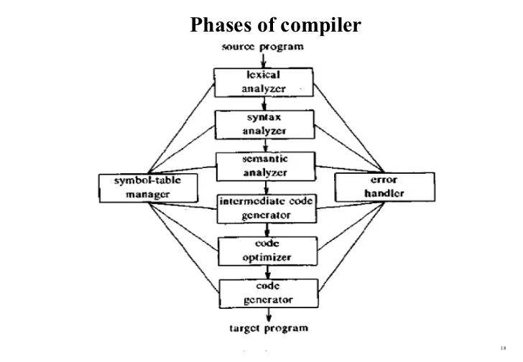
Flow Chart

Slide 12
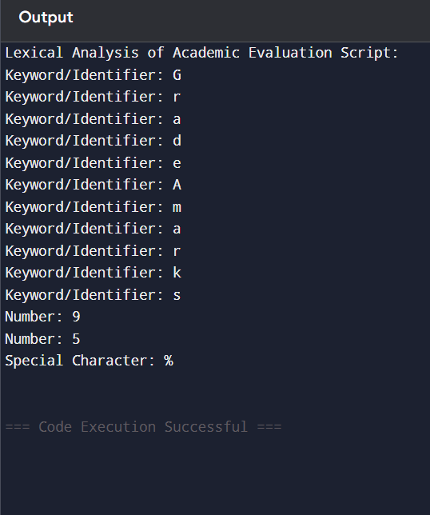
Output

Slide 13
Discussion on Implementation Outcomes
Model Effectiveness • The proposed model demonstrated significant improvements in automated text analysis and academic evaluation.
NLP Benefits • Integration of Natural Language Processing (NLP) improved the system’s ability to handle variations in student language.
Flaws Addressed • Overcame ambiguity in keyword recognition and misclassification of terms, which were common in previous evaluation systems.
User Engagement • Provided an interactive analysis of student responses, offering instant feedback on errors and suggesting improvements.
Future Applications • The model can be adapted for grading essays, programming assignments, and structured academic texts.
Overall Satisfaction • Educators and students reported high satisfaction, appreciating the speed, fairness, and consistency of automated grading.

Slide 14
Future Enhancements for Lexical Analysis of Academic Evaluation Scripts
Vision • To transform academic evaluation through intelligent and automated lexical analysis, ensuring fair, consistent, and efficient assessment of student responses.
Mission • To develop innovative, AI-powered evaluation tools that leverage compiler design techniques for accurate academic assessment.
Values • Accuracy & Fairness: Ensuring unbiased, consistent, and reliable assessments through advanced lexical analysis.

Slide 15
Technological Advancements
Natural Language Processing (NLP) Integration • Advanced NLP models enable precise lexical and syntactic analysis of academic scripts.
Artificial Intelligence (AI)-Powered Lexical Analysis • AI-driven systems improve token classification and error detection in student responses.
Automated Tokenization and Syntax Parsing • Advanced tokenization algorithms break down complex academic text into meaningful components.
Cloud-Based Compiler Technology • Cloud computing enables scalable and real-time lexical analysis of large volumes of scripts.
Blockchain for Secure Evaluation Records • Blockchain ensures transparency, security, and immutability in academic assessments.
Real-time Feedback • Providing immediate corrective feedback during language practice.

Slide 16
Interactive Query Handling in Compilers
Receive Query • The compiler receives user queries for language processing and analysis.
Process Query • Natural language processing techniques are utilized to analyze and interpret the query.
Generate Feedback • Feedback is generated based on the analysis, providing insights or corrections.
Respond User • The response is delivered to the user, closing the interaction loop.

Slide 17
User Feedback and Adjustments
Surveys • Utilize surveys to collect user opinions and suggestions. Feedback Forms • Implement feedback forms for users to report their suggestions easily.
Beta Testing • Engage users in beta testing to gather preliminary feedback on features.
Focus Groups • Organize focus groups to discuss and evaluate key functionalities.
Improvement Tracking • Track changes made based on feedback to evaluate their effectiveness.

Slide 18
Conclusion
The application of lexical analysis in academic evaluation scripts demonstrates the potential of compiler design principles in automating and enhancing the grading process.
The use of finite state automata and regular expressions enables precise classification of textual components, reducing manual effort and improving grading accuracy.
Furthermore, this method supports scalability, allowing educational institutions to assess a large volume of responses efficiently.
Despite its benefits, challenges remain, including the handling of complex sentence structures and contextual understanding, which require deeper levels of analysis beyond lexical processing.
Future research should focus on integrating natural language processing (NLP) techniques to improve comprehension and adaptability.

Slide 19
References
Alireza Ahadi, Arto Hellas, Petri Ihantola, Ari Korhonen, and Andrew Petersen. 2016. ACM, New York, NY, USA, 2--11Jurafsky, D., & Martin, J. H. (2023). Speech and Language Processing (3rd ed.). Pearson.
Paul Ayres and John Sweller. 1990. Locus of Difficulty in Multistage Mathematics Problems. The American Journal of Psychology 103, 2 (1990), 167—193
Titus Barik. 2018. Error Messages as Rational Reconstructions. Ph.D. Dissertation. North Carolina State University, Raleigh.
Brett A. Becker. 2015. An Exploration Of The Effects Of Enhanced Compiler Error Messages For Computer Programming Novices. Masters Thesis. Dublin Institute of Technology

Slide 20
Thank You!

